Slide 1
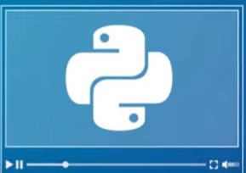
COSC 1336 Fundamentals of Programming
Python - Functions

Slide 2
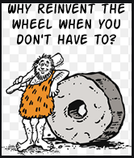
Why Reinvent The Wheel?
When we program, don’t reinvent the wheel
Our Mantra, “Write Once, Use Often”
We follow a philosophy of reuse

Slide 3
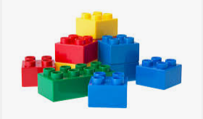
Philosophy Of Reuse
Identify anything that you do over and over again
Separate out commonly used chunks of code into reusable functions
Functions are used like Legos to assemble programs

Slide 4
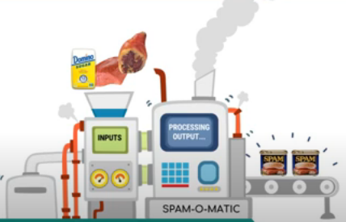
Python Functions
Functions in programming are similar to functions in Math: they may receive input values and produce output
In programming, you can create functions that do far more than perform mathematical calculations

Slide 5
Python Functions
A function is nothing more than a series of commands organized that does a single thing
# how to output to screen print(“I am AllyBaba”) # how to ask user for info height = input(“Enter height”)
You have already used many built-in Python functions to get stuff done: print, input

Slide 6
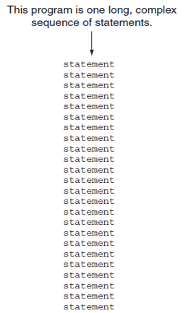
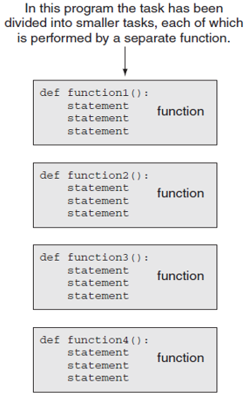
Python Functions
Functions reduce lines of code in your main program by letting you avail predefined features multiple times without having to repeat its set of codes again
DRY – Don’t Repeat Yourself
Functions are reusable tasks

Slide 7
Python Functions
Simpler code
Code Reuse - Write the code once and call it multiple times
Faster Development
Better Testing - Can test and debug each function individually
Easier Facilitation of Teamwork - Different team members can write different functions

Slide 8
Python Functions – How to Write
Function blocks starts with keyword def followed by function name with parentheses ( ) and colon (:)
Any input parameters/arguments is placed within these parentheses.
Before you start the function, add documentation to write the main purpose of the function
The code block within every function starts after the colon (:) are indented
Statement return exits a function to optionally pass back an expression to the caller.

Slide 9
Python Functions – Naming
Naming Rules
Cannot use key words as a function name Cannot contain spaces First character must be a letter or underscore All other characters must be a letter, number or underscore Uppercase and lowercase characters are distinct Function name should be descriptive of the task carried out by the function Often includes a verb

Slide 10
Python Functions – Blocks/Suite
Set of statements that belong together as a group of tasks that the function will accomplish Each block must be indented IDLE automatically indents the lines in a block Blank lines that appear in a block are ignored

Slide 11
Python Functions – Parameters
By default, parameters have a positional behavior, and you need to inform them in the same order that they were defined from the caller

Slide 12
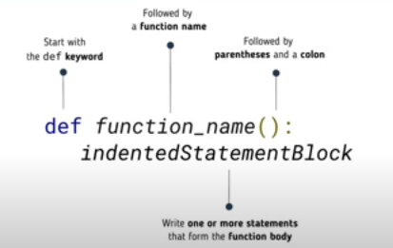
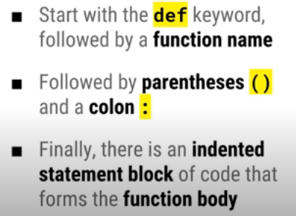
Python Functions – Syntax
Start with the def keyword followed by function name
Followed by parenthesis () and a colon :
Finally, there is an indented statement block of code that forms the function body

Slide 13
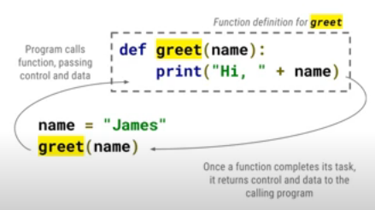
Python Functions – Example
First line of a function is called the function header; and the rest, the function body
The function greet() is called by the program (caller)
It passes the control and data to greet()
Function greet() executes the block of codes
Once greet() completes it tasks, it returns control to the calling program (caller)

Slide 14
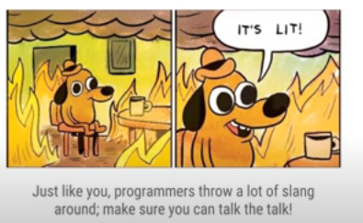
Python Functions – How to say
When you execute a function, you are “calling” it, you are the “caller”
Functions define parameters, but you “pass” in values known as “arguments” or “parameters”

Slide 15
Python Functions – Example
Here is a simple function bark()
Tracing the code
Line 1: comments
Line 2: starts with def: means it knows that there is a function bark()
It jumps over the block(suites) of codes which are followed by : and indented
Line 4: white space
Line 5: Comments
Line 6: caller calling the function bark ()
CONTROL goes to function bark()
Line 3: executes the block
After lines in function bark() executes, the control is return to caller
Returns to Line 7
1 | # declare a function
2 | def bark():
3 | print(“Who let the dogs out?”)
4
5 | # Using the function in your code
6 | bark()
7
Output | Who let the dogs out?

Slide 16
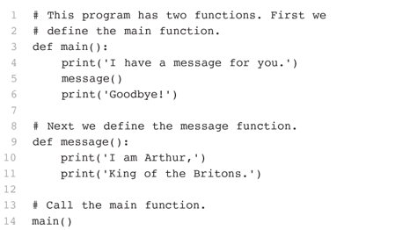

Python Functions – Example

Slide 17
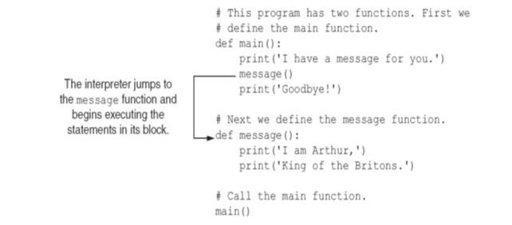
Python Functions – Example

Slide 18
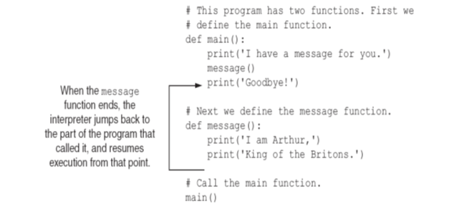
Python Functions – Example

Slide 19
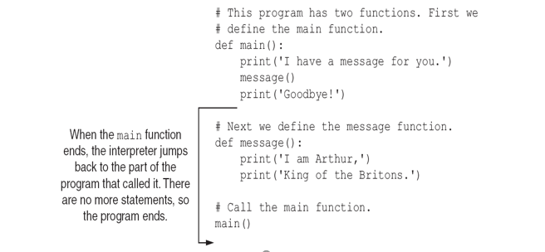
Python Functions – Example

Slide 20
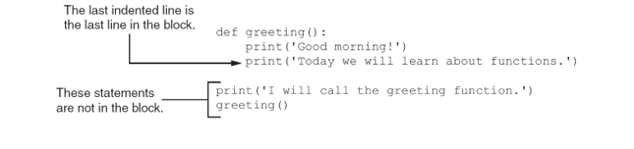
Python Functions – Indentation

Slide 21
Python - Function Arguments (Parameters)
Parameter variable
The parameter and the argument reference the same value
General format: def function_name(parameter):
Scope of a parameter exists inside the function
Argument
Assigned the value of an argument when the function is called
Function can use arguments for calculations
When calling the function, the argument is placed in parentheses following the function name
Piece of data that is sent into a function

Slide 22
Python - Function Arguments
Required arguments
To call the function printMe(), you definitely need to pass one argument, otherwise it gives a syntax error
Arguments passed to a function are in correct positional order
The number of arguments in the function call should match exactly with the function definition
# Function will print the parameter
def printMe(myName):
print (“Hello “, myName)
return # this is optional
# Now you can call printMe() function
myName = “I am Ally Baba”
printMe(myName)

Slide 23
Python - Function Arguments
Keyword arguments
This allows you to skip arguments or place them out of order because the Python interpreter is able to use the parameter names provided to match the values with parameters
When you use arguments in a function call, the caller identifies the arguments by the parameter name
You can also make keyword calls to the printInfo() function
# Function definition is here
def printInfo( name, age ):
print ("Name: ", name)
print ("Age ", age)
return
# Now you can call printInfo() function
printInfo( age = 50, name = “AllyBaba" )

Slide 24
Python - Function Arguments
A default argument
Argument that assumes a default value if a value is not provided in the function call for that argument
The following example gives an idea on default arguments, it prints default age if it is not passed
# Function definition is here
def printInfo( name, age = 35 ):
print (“My Name: ", name)
print (“My Age ", age)
return
# Now you can call printInfo() function
printInfo( age = 50, name = “AllyBaba" )
printInfo( name = “Scooby Doo" )

Slide 25
Python - Function Arguments
Variable-length arguments
You can process a function for more arguments than you specified
An asterisk (*) is placed before the variable name that holds the values of all non keyword variable arguments
It saves the additional parameters in Tuple
This tuple is empty when no additional arguments are specified during the function call
# Function definition is here
def printInfo( arg1, *varTuple ):
print ("Output is: ")
print (arg1)
for var in varTuple:
print (var)
# Now you can call printInfo() function
printInfo( 10 )
printInfo( 70, 60, 50 )

Slide 26
Python - Function Arguments
1 | def main():
2 | value = 5
3 | showDouble(value)
4
5 | def showDouble(number):
6 | result = number * 2
7 | print(result)
 | value
5
 | number
5
 | result
10
Output | 10

Slide 27
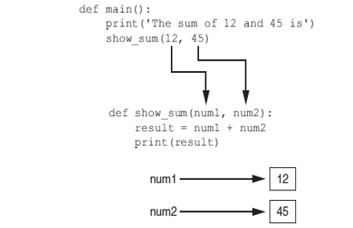
Python - Function Arguments

Slide 28
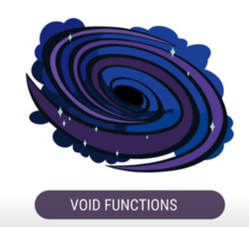
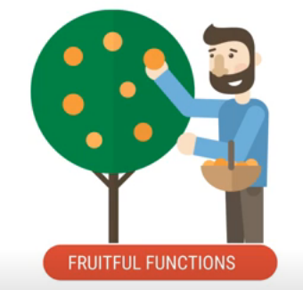
Python - Function Types
Think of void functions as a black holes; something happens but nothing is returned to the caller
print()
Think of fruitful functions as trees that bear fruit; they produce and return something to the caller
input()

Slide 29
Python – Arguments - Pass by value
Pass by value
Provides a way for unidirectional communication between
Calling function can communicate with caller
Changes made to a parameter value within the function do not affect the actual parameter

Slide 30
Python – Arguments - Pass by value
1 | def main():
2 | value = 99
3 | print(‘The value is’, value)
4 | changeMe(value)
5 | print(‘Back in main the value is’, value)
6
7 | def changeMe(arg):
8 | print(‘I am changing the value.’)
9 | arg = 0
10 | print(‘Now the value is’, arg)
11
12 | main()
 | value
99
 | arg
99
0

Slide 31
Python – Arguments - Pass by value
1 | def main():
2 | numberOne = 9
3 | numberOne = 7
4 | print(‘The values are’, numberOne, “ , “, numberOne)
5 | changeMe(numberOne, numberOne)
6 | print(‘Back in main, the values are’, numberOne, numberOne)
7
8 | def changeMe(arg1, arg2):
9 | print(‘I am doing calculation.’)
10 | arg1 = arg1 + arg2
11 | print(‘Inside the function, the values are ’, arg1, “ , “, agr2)
12
13 | main()
14
 | numberOne
9
 | numberTwo
7
Screen Display
The values are are 9, 7
Screen Display
Back in main, the values are 9, 7
 | arg1
9
 | arg2
7
16
Screen Display
I am doing calculation.
Screen Display
Inside the function, the values are 16, 7

Slide 32
Python – Arguments - Pass by Reference
Pass by Reference
Parameters (arguments) in the Python language are some instance passed by Reference.
It means if you change what a parameter refers to within a function, the change also reflects back in the calling function.
# Function definition is here
def changeMe( myList ):
myList.append([1,2,3,4]);
print ("Values inside the function: ", myList)
# Now you can call changeMe() function
myList = [10,20,30];
changeMe( myList );
print ("Values outside the function: ", myList)
Screen Display
Values inside the function: [10, 20, 30, [1, 2, 3, 4]] Values outside the function: [10, 20, 30, [1, 2, 3, 4]]

Slide 33
Python – Arguments - Pass by Reference
Pass by Reference
Argument is being passed by reference and the reference is being overwritten inside the called function
# Function definition is here
def changeMe( myList ):
"This changes a passed list into this function"
myList = [1,2,3,4]; # This would assign new reference in myList
print ("Values inside the function: ", myList)
# Now you can call changeMe() function
myList = [10,20,30];
changeMe( myList );
print ("Values outside the function: ", myList)
Screen Display
Values inside the function: [1, 2, 3, 4] Values outside the function: [10, 20, 30]

Slide 34
Python – Return statement
The statement return [expression] exits a function, optionally passing back an expression to the caller.
A return statement with no arguments is the same as return None.
# Add both the parameters and return them
def sumNumbers( arg1, arg2 ):
addition = arg1 + arg2
print ("Inside the function : ", addition)
return addition
# Now you can call sum function
total = sumNumbers( 10, 20 )
print ("Outside the function : ", total)
 | arg1
10
 | arg2
20
 | addition
30
Screen Display
Inside the function : 30
Statement
total = sum( 10, 20 )
 | total
10
Screen Display
Outside the function : 30

Slide 35
Python – Return statement
A function can return multiple values
Specified after the return statement separated by commas
Format: return expression1,expression2, etc.
When you call such a function in an assignment statement, you need a separate variable on the left side of the = operator to receive each returned value
# function returns multiple values
def addMoney():
return 1, 2, 3
x, y, z = addMoney()
print (x, y, z)

Slide 36
Python – Multiple Return statement
# function returns multiple values
def addMoney(number):
if (number < 0):
return "Negative Number"
elif (number == 0):
return "Zero"
else:
return "Positive Number"
# caller of function
value = addMoney(-5)
print (value)

Slide 37
Python – Multiple Functions for same operation
# getData1() gets the salary from the user input
def getData1():
salary = float(input('Please enter your base salary '))
return salary
# getData2() gets the bonus from the user input
def getData2():
bonus = float(input('Please enter your the bonus '))
return bonus
# main() performs all the programming
def main():
salary = getData1()
bonus = getData2()
# main() is used to initiate the stage of the program
main()

Slide 38
Python – One Function for same operation
# getData1() gets value from user input
def getData(prompt):
value = float(input(prompt))
return value
# main() performs all the programing
def main():
# getting users input for salary and bonus
salary = getData('Please enter your base salary ')
bonus = getData('Please enter your the bonus ')
# main() is used to initiate the stage of the program
main()

Slide 39
Python – Function for calculation
# getData1() gets value from user input
def getData(prompt):
value = float(input(prompt))
return value
# main() performs all the programing
def main():
# getting users input for salary and bonus
salary = getData('Please enter your base salary ')
bonus = getData('Please enter your the bonus ')
# calculation section
totalSalary = salary + bonus
# main() is used to initiate the stage of the program
main()

Slide 40
Python – Function for calculation
# getData1() gets value from user input
def getData(prompt):
value = float(input(prompt))
return value
# main() performs all the programming
def main():
# getting users input for salary and bonus
salary = getData('Please enter your base salary ')
bonus = getData('Please enter your the bonus ')
# finding the total salary
totalSalary = processData(bonus, salary)
# processData() will find the total salary
def processData(bonus, salary):
return bonus + salary
# main() is used to initiate the stage of the program
main()

Slide 41
Python – Function for calculation
# getData1() gets value from user input
def getData(prompt):
value = float(input(prompt +'$'))
return value
# processData() will find the total salary
def processData(bonus, salary):
return bonus + salary
# printData() will display results on the screen
def printData(totalSalary):
print('My monthly income is $', format(totalSalary, '7.2f'))
# main() performs all the programing
def main():
# getting users input for salary and bonus
salary = getData('Please enter your base salary ')
bonus = getData('Please enter your the bonus ')
# finding the total salary
totalSalary = processData(bonus, salary)
# display results to screen
printData(totalSalary)
# main() is used to initiate the stage of the program
main()

Slide 42
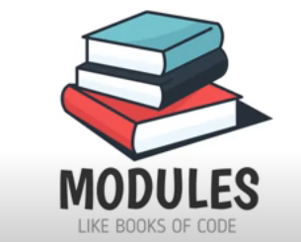
Python - Modules
A module is a collection of related functions and other definitions, normally placed in their own file
You can use existing modules – like checking out books of code from a library – or create your own

Slide 43
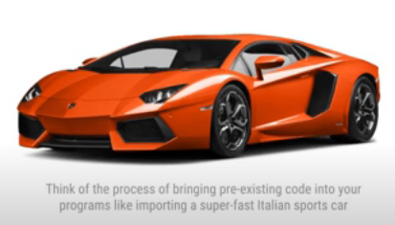
Python - Modules
To use a module, first include it in your program, - using the import keyword – then call it from your code
Some useful modules you may want to use: math, random, time

Slide 44
Python - Modules
#import math
import math
print('The value of pi is ', math.pi)
In this program, we import the math module and then use its pi function to find the value of pi
Notice how we prefix the call to the function with the name of the module

Slide 45
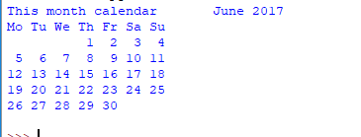
Python - Modules
In this program, we import the calendar module and then use its month function to find the value of month
import calendar
print('This month calendar ', calendar.month(2017,6))

Slide 46
Python - Modules
In this program, we import the statistics module and then use its mode function to find the value of mode
import statistics
print('The mode is ', statistics.mode([1,1,2,1,3]))

Slide 47
Python - Modules
In this program, we import the random module and then use its randinit function to generate a random integer between 1 and 6
import random
number = random.randint(1,6)
print('An integer between 1 and 6 is ' ,number)

Slide 48
Python - Modules
# This program will toss a coin
import random
coinToss = random.randint(0, 1)
print('1 is for head; 0 is for tail; And I got' ,coinToss)
# This program will find the hypotenuse of a right triangle
import math
a = 3
b = 4
c = math.hypot(a, b)
print('The hypotenuse is ' , c)

Slide 49
Python - Locating Modules
When you import a module, the Python interpreter searches for the module in the following sequences −
The current directory
If the module isn't found, Python then searches each directory in the shell variable PYTHONPATH
If all else fails, Python checks the default path. On UNIX, this default path is normally /usr/local/lib/python/
The module search path is stored in the system module sys as the sys.path variable.
The PYTHONPATH is an environment variable, consisting of a list of directories.
Here is a typical PYTHONPATH from a Windows system:
set PYTHONPATH=c:\python20\lib;
The sys.path variable contains the current directory, PYTHONPATH, and the installation-dependent default.
The syntax of PYTHONPATH is the same as that of the shell variable PATH.

Slide 50
Python - Modules
# This will a module created by me
# it finds the cube of a number
def cube(number):
return number * number * number
# This program will import my own module
import cubeModule
value = cubeModule.cube(2)
print('The cube of 2 is ' , value)

Slide 51
Python - Scope of Variables
All variables in a program may not be accessible at all locations in that program.
The scope of a variable determines the portion of the program where you can access a particular identifier.
Global variables
Local variables
This depends on where you have declared a variable.
There are two basic scopes of variables in Python

Slide 52
Python - Scope of Variables
Local variable
Belongs to the function in which it was created
Only statements inside that function can access it, error will occur if another function tries to access the variable
Function in which created
Variable that is assigned a value inside a function
Local variable cannot be accessed by statements inside its function which precede its creation
Different functions may have local variables with the same name
Each function does not see the other function’s local variables, so no confusion

Slide 53
Python - Scope of Variables
Global variable
Can be accessed by any statement in the program file, including from within a function
If a function needs to assign a value to the global variable, the global variable must be re-declared within the function
General format: global variable_name
Created by assignment statement written outside all the functions

Slide 54
Python - Scope of Variables
Avoid using global variables
Global variables making debugging difficult
Many locations in the code could be causing a wrong variable value
Functions that use global variables are usually dependent on those variables
Makes function hard to transfer to another program
Global variables make a program hard to understand

Slide 55
Python - Scope of Variables
Global constant
Permissible to use global constants in a program
To simulate global constant in Python, create global variable and do not re-declare it within functions
Global name that references a value that cannot be changed

Slide 56
Python - Scope of Variables
Global variable
MONEY = 1
def addMoney():
global MONEY
MONEY = MONEY + 1
print ("Before function is called", MONEY)
addMoney()
print ("After function is called", MONEY)
Screen Display
Before function is called 1 After function is called 2

Slide 57
Python - Designing to Use Functions
In a flowchart
Function name written in the symbol
Typically draw separate flow chart for each function in the program
End terminal symbol usually reads Return
Top-down design
Function call shown as rectangle with vertical bars at each side
Technique for breaking algorithm into functions
Python -

Slide 58

Python - Designing Program to Use Functions

Slide 59
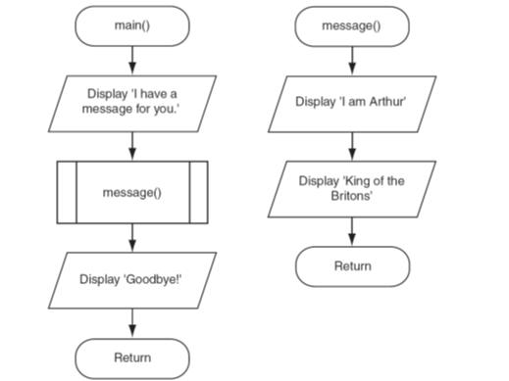
Python – Flow Chart for Program

Slide 60
Python – Hierarchy Chart for Program
Hierarchy chart
Box for each function in the program, Lines connecting boxes illustrate the functions called by each function
Does not show steps taken inside a function
Depicts relationship between functions

Slide 61
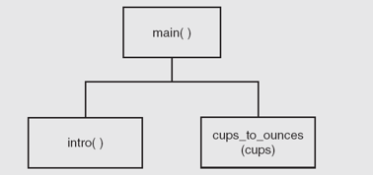
Python – Hierarchy Chart for Program

Slide 62
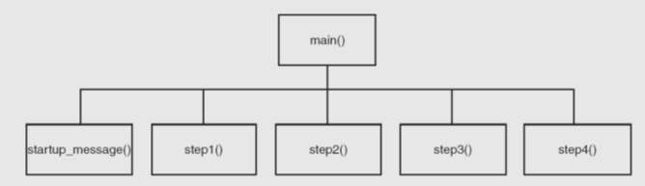
Python – Hierarchy Chart for Program

Slide 63
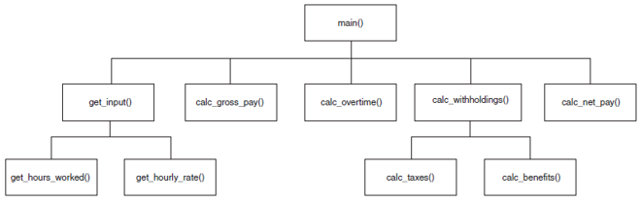
Python – Hierarchy Chart for Program

